Slide 1
The building blocks
Learning objectives:
By the end of this lecture you should be able to:
    distinguish between the eight built in scalar types of Java;
    declare variables;
    assign values to variables;
    create constant values with the keyword final;
    join messages and values in output commands by using the concatenation (+) operator;
    use the Scanner class to get data from the keyboard;
    design the functionality of a method using pseudocode.

Slide 2

An illustration of a program without data
A program controlling the space shuttle would not be very useful if it could not record the shuttle's co-ordinates !
?

Slide 3
  Simple data types in Java
The types of value used within a program are referred to as data types.
price of a cinema ticket : real number
how many tickets sold : integer
In Java there are a few simple data types that programmers can use.
Often referred to as the scalar types

Slide 4
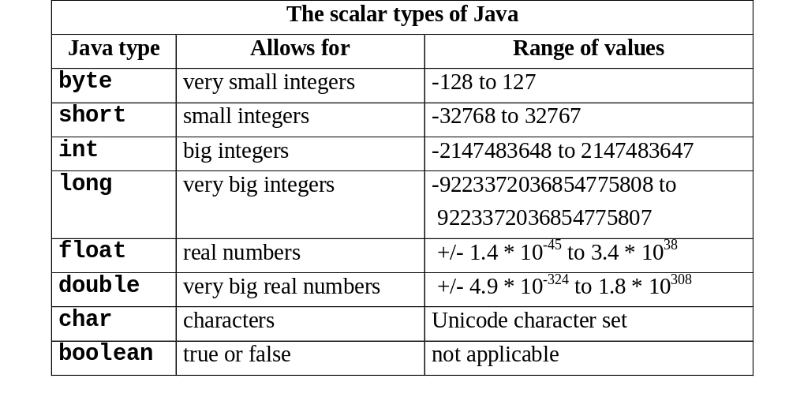

Slide 5
  Declaring variables in Java
the procedure of creating named locations in the computer's memory that will contain values while a program is running;
these named locations are called variables because their values are allowed to vary over the life of the program.
To create a variable in your program you must:
give that variable a name (a sensible name of your choice);
decide which data type in the language best reflects the kind of values you wish to store in the variable.

Slide 6
Naming variables
You can choose any name for variables as long as
    the name is not already a word in the Java language (such as class, void);
    the name has no spaces in it;
    the name does not include operators such as + and -;
    the name starts either with a letter, an underscore (_), or a dollar sign ($).
The convention in Java programs is to begin the name of a variable with a lowercase letter.

Slide 7
Choosing a suitable data type
Four Java types can be used to hold integers (byte, short, int and long).
Two Java types that can be use to hold real numbers (double and float).
The difference among these types is the range of values that they can keep, however
    the int type is often chosen to store integers
    the double type often chosen to store real numbers
Once name and type decided upon, the variable is declared as follows:
dataType variableName ;

Slide 8
Declaring a variable: an example
Let’s create a variable to keep a player’s score in a computer game.
a score will always be a whole number
good meaningful name
int score ;

Slide 9
The effect of declaring a variable in Java
Computer Memory
Java Instruction
int score ;
score

Slide 10
Declaring many variables
Assume that the player of a game can choose a difficulty level (A, B, or C).
int score; // to hold score
char level; // to hold difficulty level

Slide 11
Declaring variables of the same type
Several variables can be declared on a single line if they are all of the same type.
Assume that there are ghosts in the house that hit out at the player; the number of times a player gets hit by a ghost can also be recorded.
int score, hits; // both the same type
char level ; // different type

Slide 12
The effect of declaring many variables in Java
Computer Memory
Java Instructions
int score, hits;
char level ;
score
hits
level

Slide 13
  Assignments in Java
Assignments allow values to be put into variables.
Written in Java with the use of the equality symbol (=), known as the assignment operator.
Simple assignments take the following form:
variableName = value;
score = 0;

Slide 14
Initializing variables
You may combine the assignment statement with a variable declaration to put an initial value into a variable as follows:
int score = 0;
Note, the following declaration will not compile in Java:
int score = 2.5 ;
This will not compile because 2.5 is a double value

Slide 15
Putting values into character variables
When assigning a value to a character variable, you must enclose the value in single quotes.
for example
set the initial difficulty level to A
char level = ‘A’;

Slide 16
Re-assigning variables
Remember: you need to declare a variable only once.
You can then assign to it as many times as you like.
char level = ‘A’;
level = ‘B’;

Slide 17
  Creating constants
Constants are data items whose values do not change. For example:
  the maximum score in an exam (100);
  the number of hours in a day (24);
  the mathematical value of π (3.1417).
Constants are declared much like variables except
  they are preceded by the keyword final
  they are always initialised to their fixed value.
final int HOURS = 24;

Slide 18
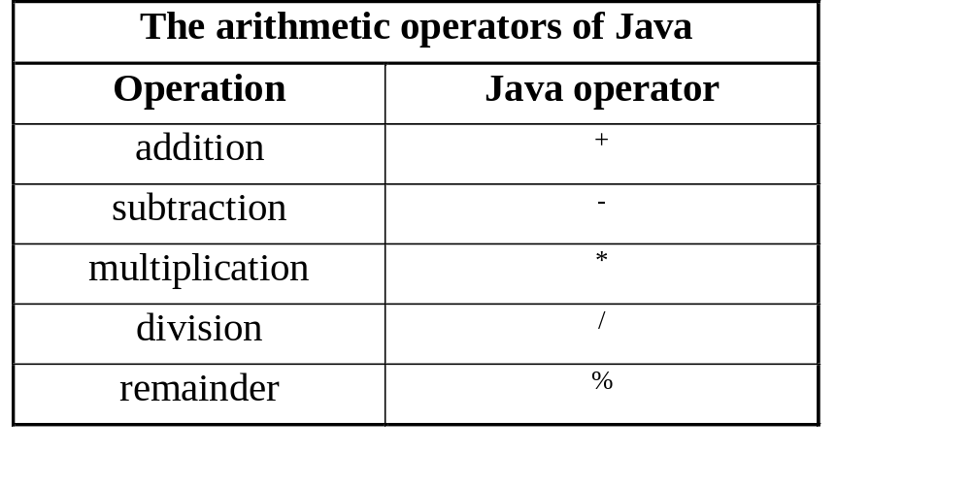
  Arithmetic operators
Java has the four familiar arithmetic operators, plus a remainder operator for this purpose.

Slide 19
Calculation: an example
Consider a calculation to work out the price of a computer after a sales tax has been added.
    initial price of computer is 500
    sales tax is 17.5%
double cost;
cost = 500 * (1 + 17.5/100) ;
After this calculation the final cost of the machine would be 587.50.

Slide 20
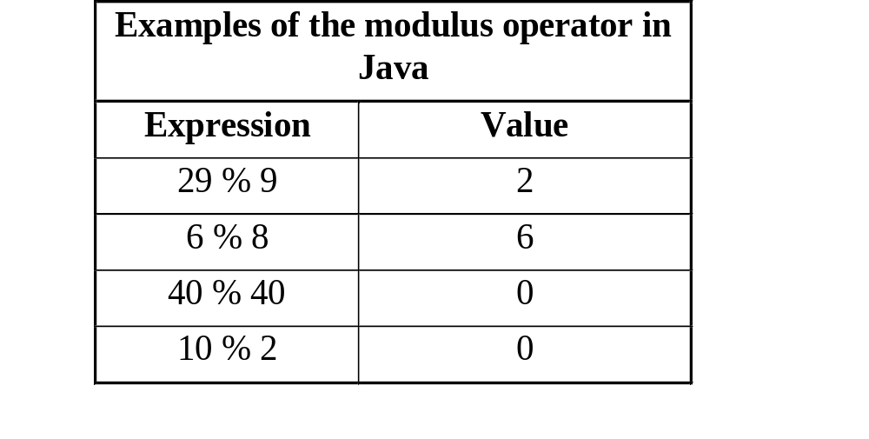
The Modulus operator
The modulus operator (%) returns the remainder after integer division

Slide 21
Modulus operator: an example
A large party of 30 people go to visit the roller coaster rides at a local theme park.
When they get to the ultimate ride, " Colossus", they are told that only groups of four can get on!
int catchRide, missRide;
catchRide = 30/4; // 7
missRide = 30%4; // 2

Slide 22
  Expressions in Java
Right-hand side of an assignment statement can itself contain variable names.
double price, tax, cost;
price = 500;
tax = 17.5;
cost = price * (1 + tax/100) ;

Slide 23
More expressions
Nothing to stop you using the name of the variable you are assigning to in the expression itself.
price = price * (1 + tax/100) ;
the new value of ‘price’
The old value of ‘price’

Slide 24
  Output in Java
To output a message on to the screen in Java we use the println() command
System.out.println(“Hello world”);
//System is a predefined final class, out is a PrintStream Object and println is a built-in overloaded method in the out object.
We call these messages strings (collections of characters).
Two strings can be joined together with the plus symbol (+), known as the concatenation operator.
System.out.println(“Hello “ + ”world”);

Slide 25
Outputting values on the screen
Values and expressions can also be printed on the screen using these output commands.
for example
30 people visiting the roller coaster, each charged an entrance fee of 7.50, the total cost of tickets could be displayed as follows:
System.out.println(“cost = ” + (30*7.5) );

Slide 26
The Scanner Class
Part of the standard Java class library.
Input – from InputStream or File source
Can be used to parse a character string into separate pieces.
Scanner scan = new Scanner(System.in);

Slide 27
The Scanner Class
Methods
Scanner(InputStream source)
Scanner(File source)
Scanner(String source)
Constructors:
sets up new scanner to scan values from a specified source.
String next()
Returns the next input token as a character string.
String nextLine()
Returns all input remaining on the current line as a character string.

Slide 28
The Scanner Class
boolean nextBoolean()
byte nextByte()
double nextDouble()
float nextFloat()
int nextInt()
long nextLong()
short nextShort()
Returns the next input token as the indicated type. Throws InputMismatchException if the next token is inconsistent with the type.
boolean hasNext()
Returns true if the scanner has another token in its input

Slide 29
Program 2.3
    import java.util.Scanner;
    class FindCost3
    {
    public static void main(String[] args)
    { Scanner scan = new Scanner(System.in);
      double price, tax;
      System.out.println(“*** Computer Price Check ***”);
      System.out.print(“Enter initial price: “);
      price = scan.nextDouble();
      System.out.print(“Enter tax rate: “);
      tax = scan.nextDouble();
      price = price * (1 + tax/100) ;
      System.out.println(”Cost after tax = “ + price);
      }
}

Slide 30
Interacting with the program
*** Computer Price Check ***
Enter initial price: 1000
Enter tax rate: 12.5%
please make sure you enter a double
12.5
Cost after tax = 1125.0

Slide 31
  Program Design
Designing a program is the task of considering exactly how to build the final product
Overall program design will be expressed using class diagrams.
At a lower level, the instructions that make up a method may also need to be designed if the method is complex.
Very often a general purpose “coding language” can be used for this purpose.
Code expressed in this way is often referred to as pseudocode.

Slide 32
Design of computer-price-check program
BEGIN
DISPLAY program title
DISPLAY prompt for price
ENTER price
DISPLAY prompt for tax
ENTER tax
SET price TO price * (1 + tax/100)
DISPLAY new price
PAUSE with message
END

